Slide 1

Deep learning: Convolutional Neural networks (CNN)
PRESIDENCY UNIVERSITY, BENGALURU
SCHOOL OF ENGINEERING
DEPARTMENT OF COMPUTER SCIENCE AND ENGINEERING
Prof. Tapas Guha
Dept. of CSE, Presidency University, Bangalore
DAY-3

Slide 2
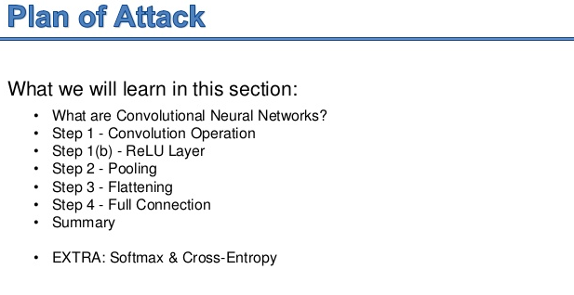

Slide 3
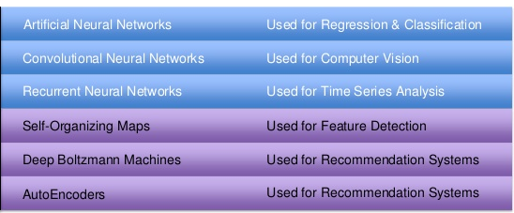
Deep Learning Models
Supervised
Unsupervised

Slide 4
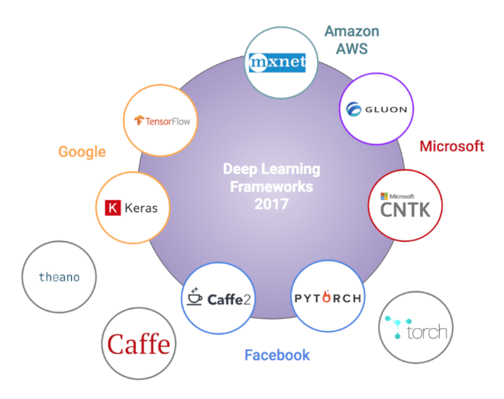
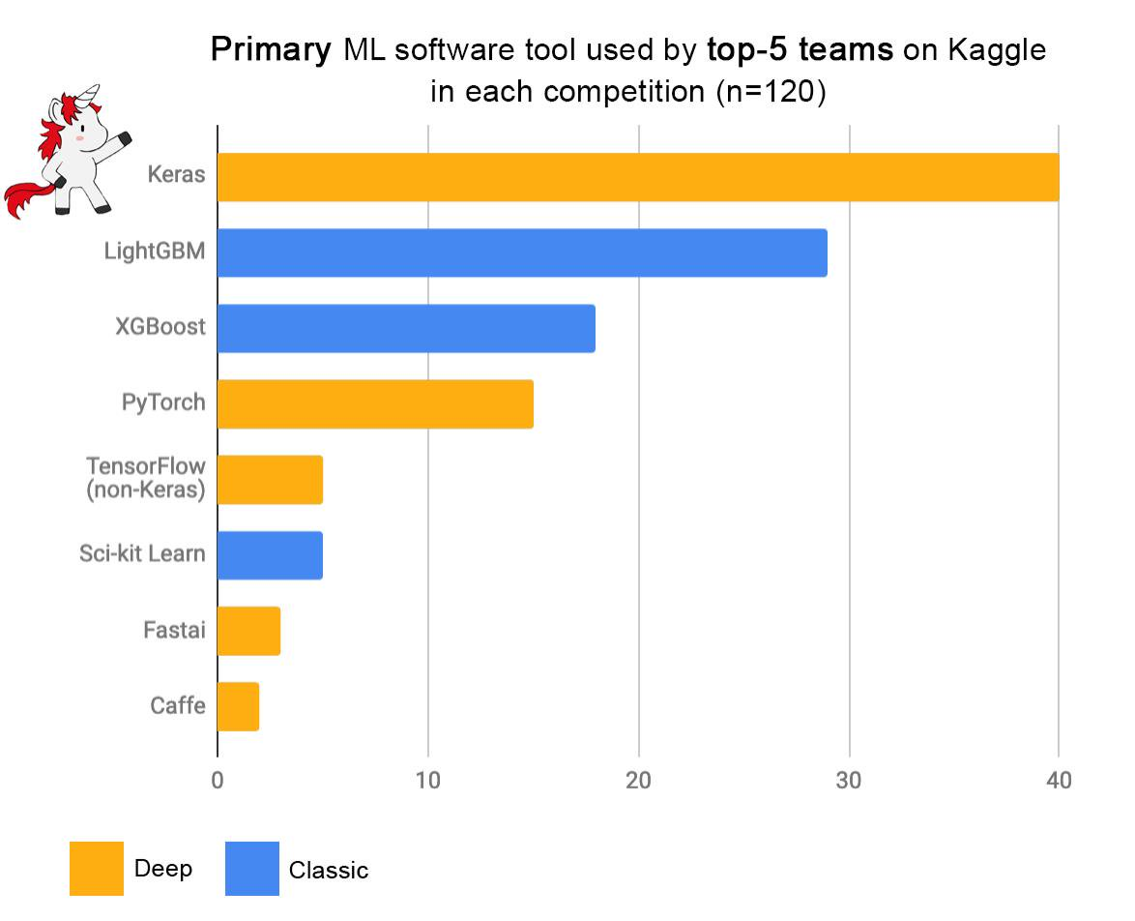
Popular Deep Learning Frameworks

Slide 5
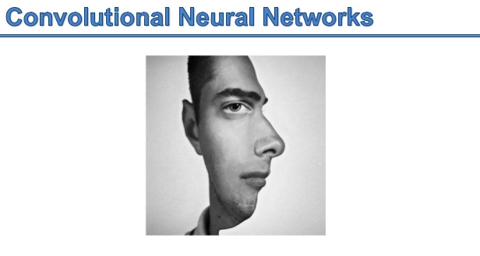

Slide 6
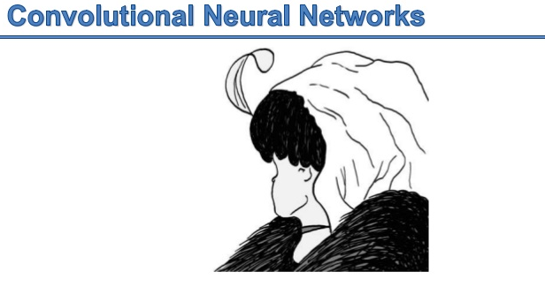

Slide 7
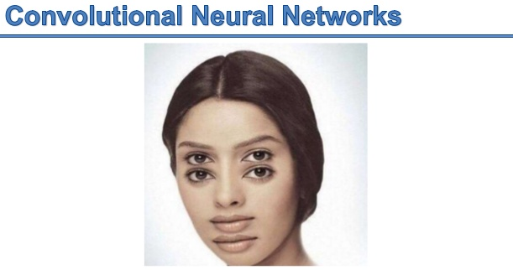

Slide 8
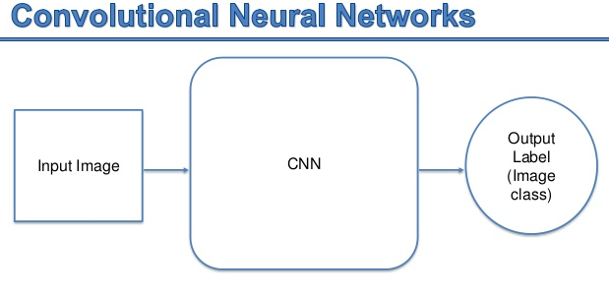

Slide 9
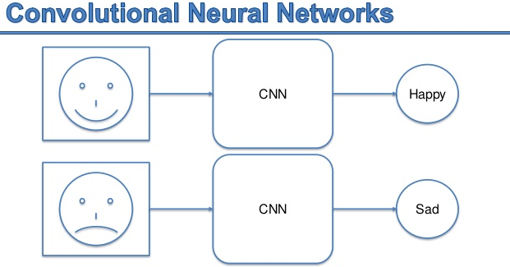

Slide 10
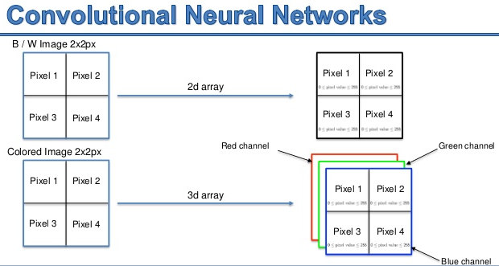

Slide 11
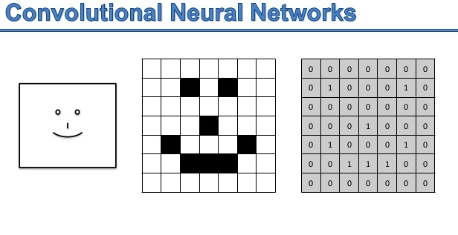

Slide 12
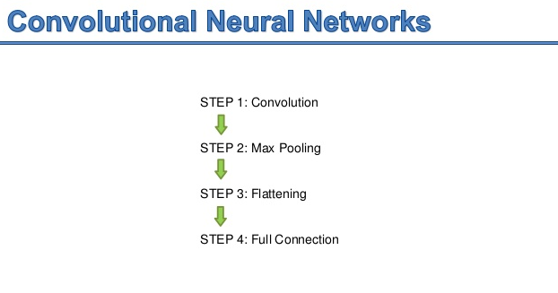

Slide 13
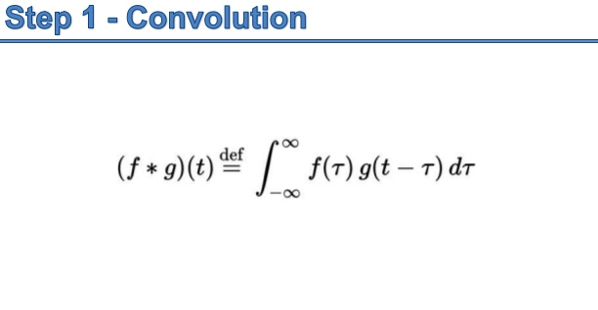

Slide 14
Simple example of convolution operation
Input, e.g. an image
1 | 3 | 5 | 2 | 4
6 | 0 | 2 | 1 | 3
6 | 3 | 1 | 3 | 6
7 | 3 | 2 | 1 | 3
5 | 3 | 0 | 0 | 2
$$c_{1} =f (0.2∗1+0.7∗3 −0.5 ∗6+0.7∗0) = f(−0.7)$$
$$c_{2} =f(0.2∗3+0.7∗5 −0.5 ∗0+0.7∗2) = f(5.5)$$
$$c_{3} =…$$
Feature map
Note: Bias terms omitted!
f(-0.7) | f(5.5) | …
f represents some non-linear activation function
Filter (Kernel)
0.2 | 0.7
-0.5 | 0.7

Slide 15
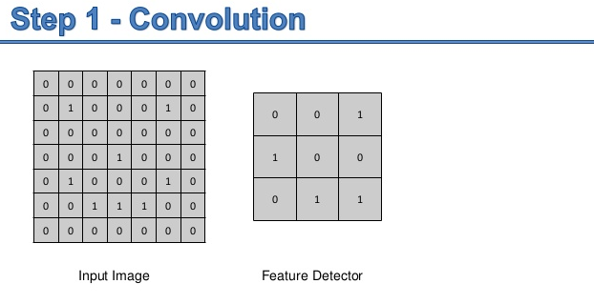

Slide 16
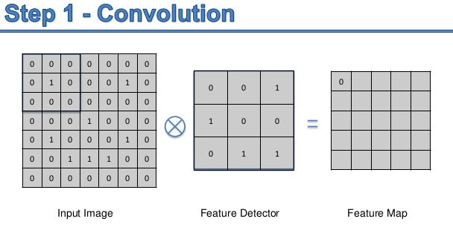

Slide 17
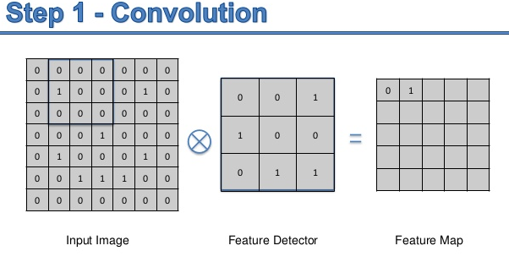

Slide 18
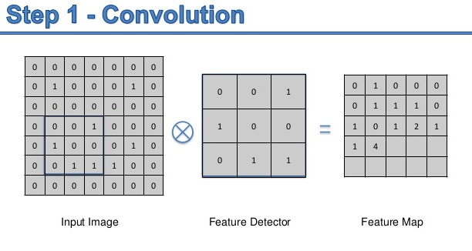

Slide 19
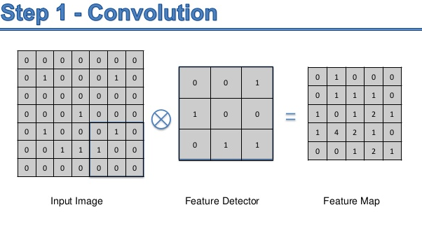

Slide 20
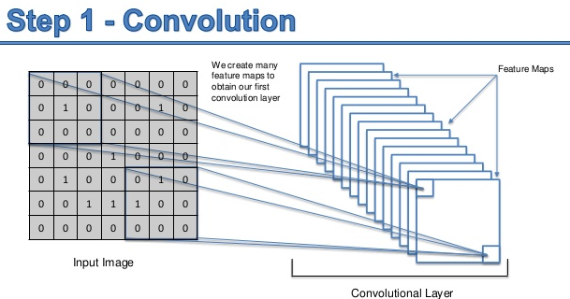

Slide 21
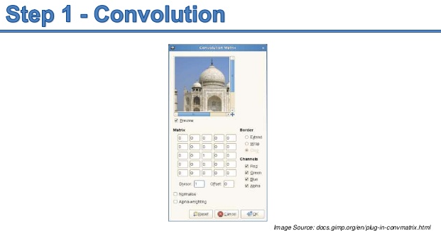

Slide 22
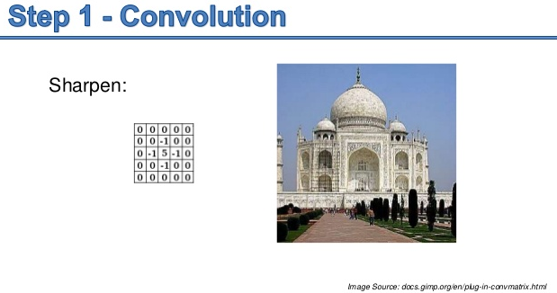

Slide 23
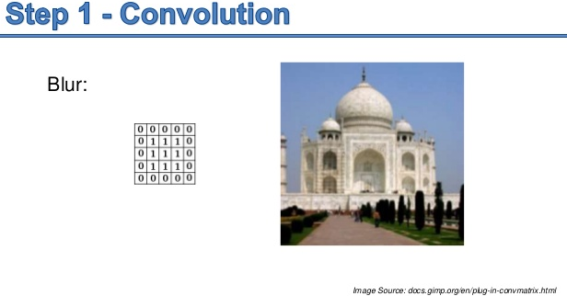

Slide 24
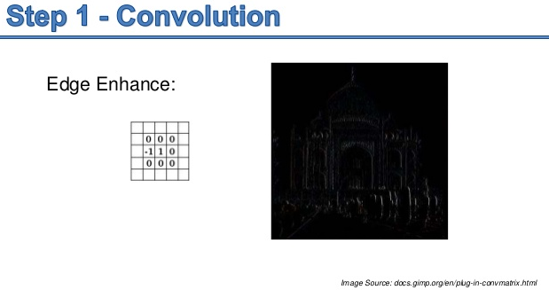

Slide 25
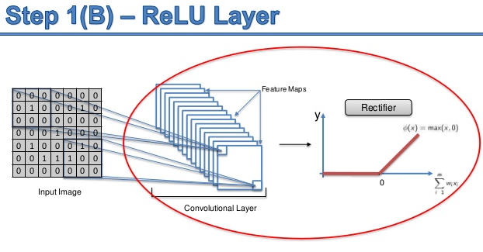

Slide 26
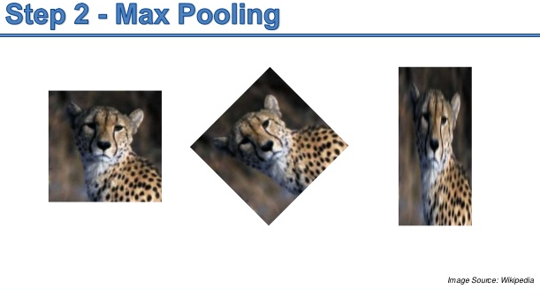
Dimensionality reduction and spatial invariance

Slide 27
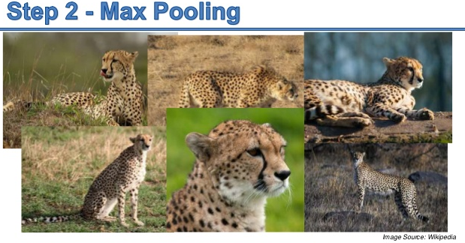

Slide 28
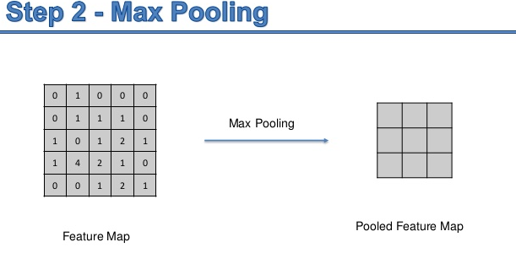
Dimensionality reduction and spatial invariance

Slide 29
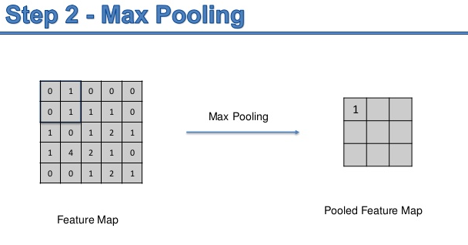

Slide 30
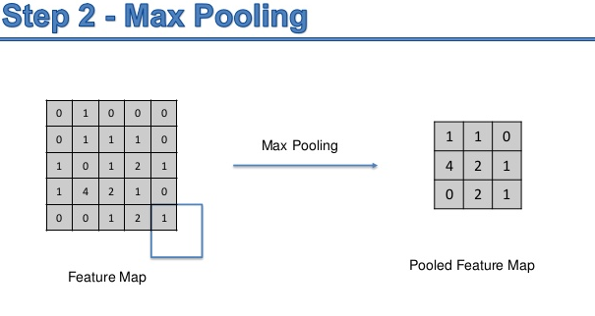

Slide 31
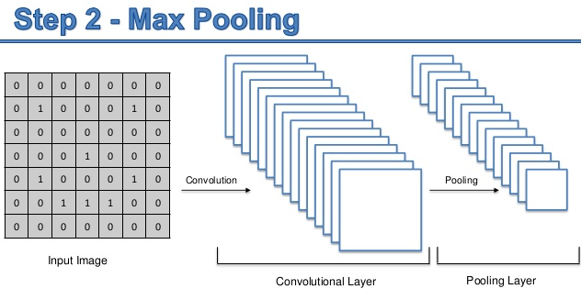

Slide 32
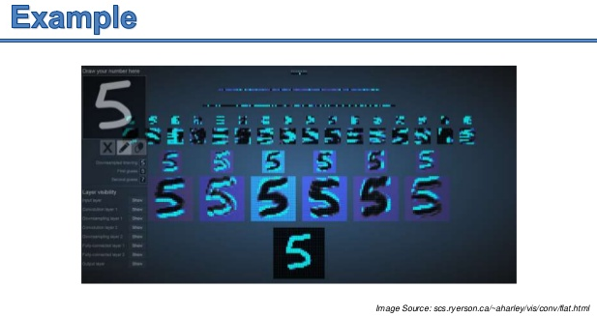
Notes:
scs.ryerson.ca/~aharley/vis/conv/flat.html

Slide 33
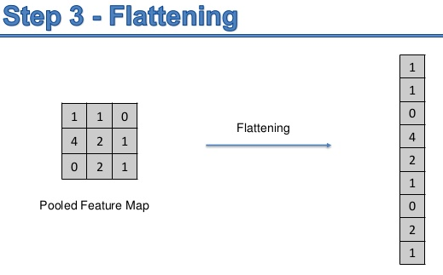

Slide 34
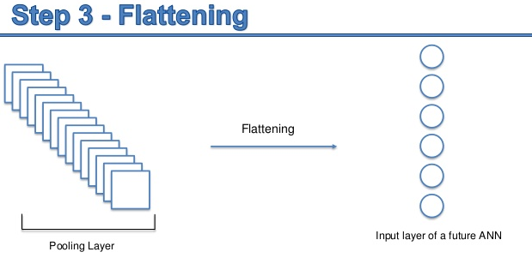

Slide 35
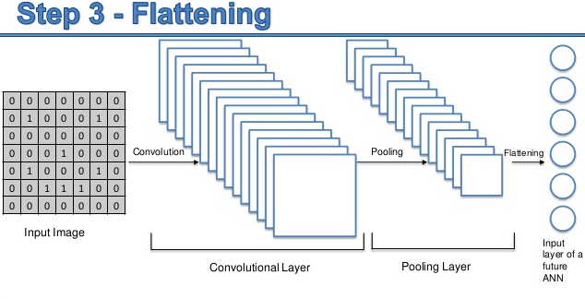

Slide 36
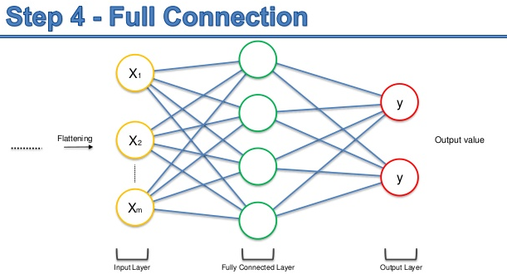

Slide 37
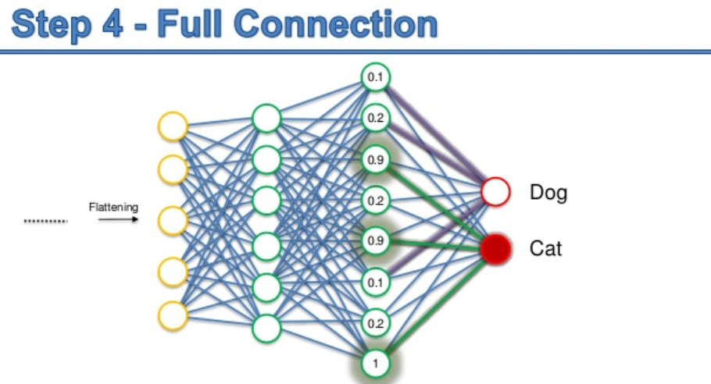

Slide 38
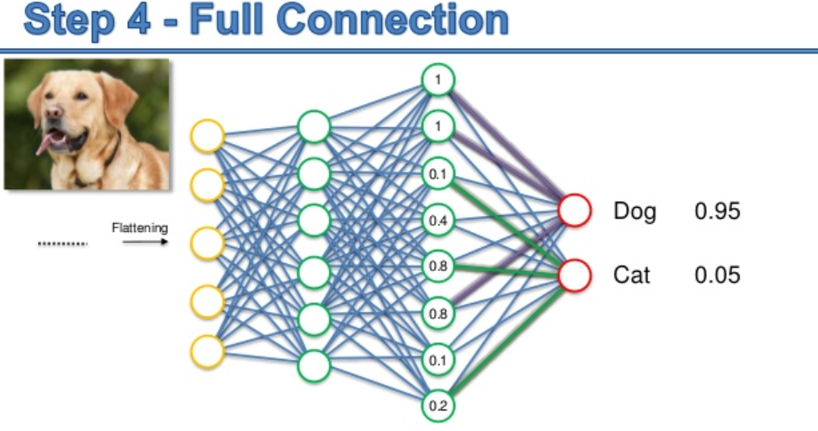

Slide 39
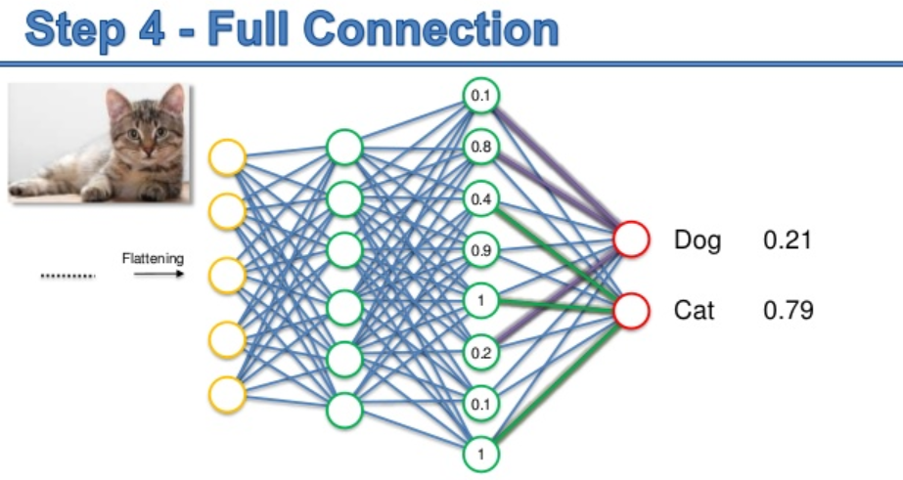

Slide 40
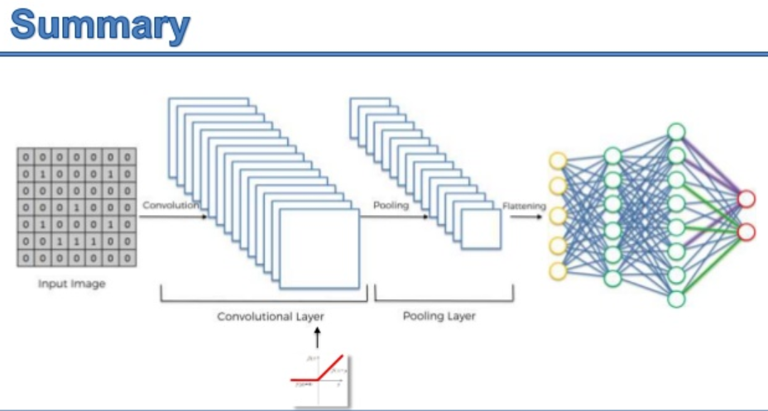

Slide 41


Slide 42
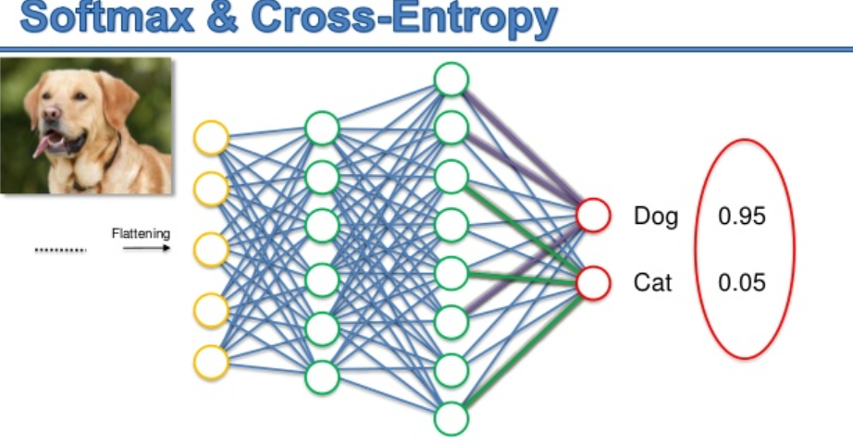

Slide 43
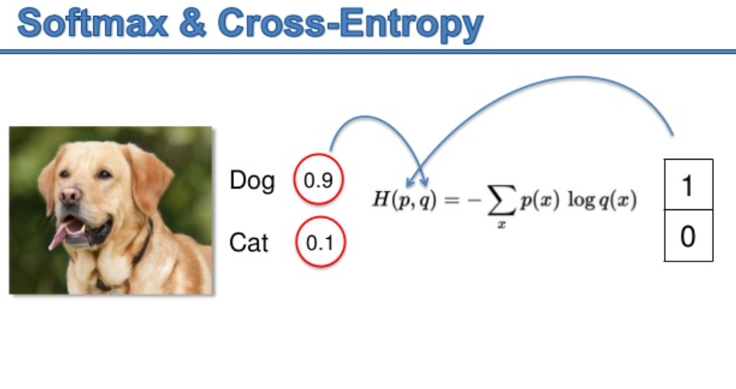

Slide 44
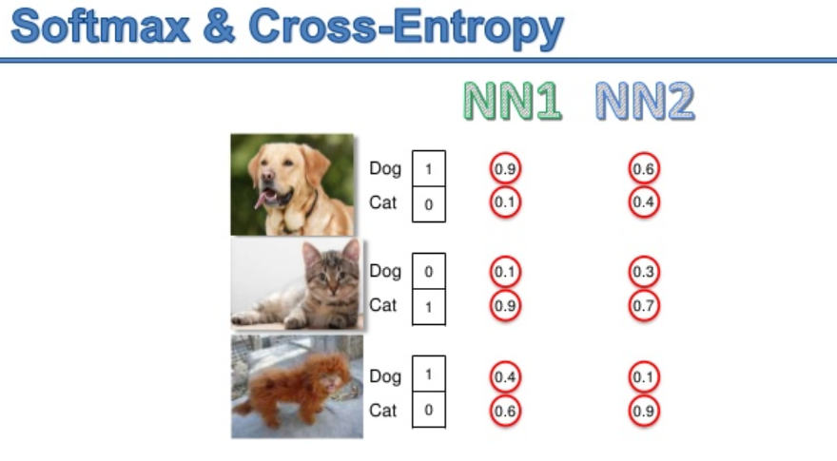

Slide 45
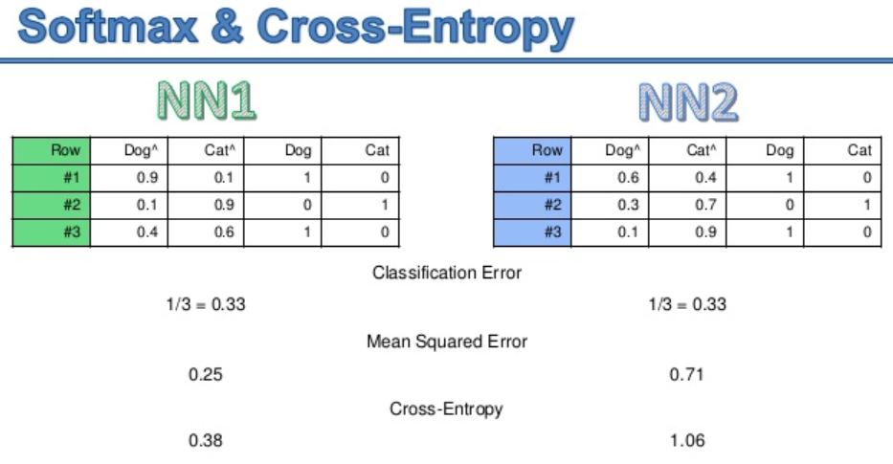

Slide 46
A lot of hyper-parameters and other decisions
Remove stopwords? (yes for word2vec, no to sentiment analysis)
Remove punctuation? (yes)
Dimension of word vectors (300)
Word2vec window size (10)
Downsampling for frequent words (1e-3)
Minimum word count for word2vec (40)
Deep Learning (DL) number of layers (3)
DL width of the hidden layers (300-150-50-2)
DL activation functions
DL use dropout (tried, did not help. -> no)
DL Initialization (random uniform between 0 and 1)
DL Optimizer (Adam)
DL Adam optimizer parameters, learning rate +3 others
DL number of training steps
DL regularization method and its parameters (none)
DL loss function (cross entropy)

Slide 47
Thank You for your patience…
Now I am open to questions…

